Slide 1
Meet Teem
Alex Gonzalez, Ben Harker, Kyle Wahlberg

Slide 2


An age old question:
Let’s talk about that

Slide 3
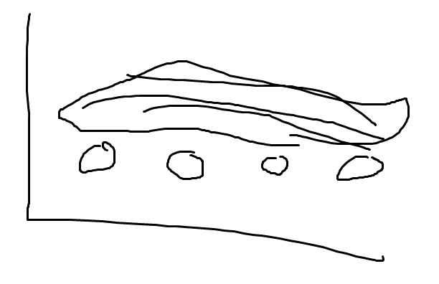
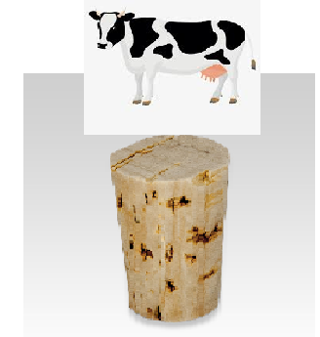
The idea
We decided to model grilling and searing meats (assuming square cuts of even thickness)
After a detailed planning session, we made a GUI
Used diffusion equations for conduction and convection
Beef quark?

Slide 4
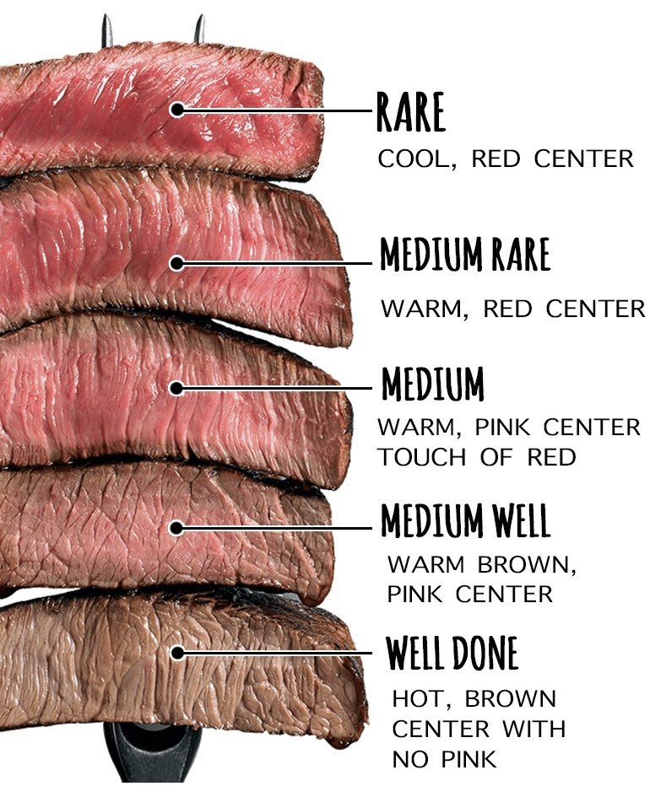
The goal
Create a model for cooking meat
Currently only beef (but others could easily be added)
Choose how well done: rare, medium rare, medium, medium well, or burnt
Choose cooking method: grill or cast iron pan
Burnt

Slide 5
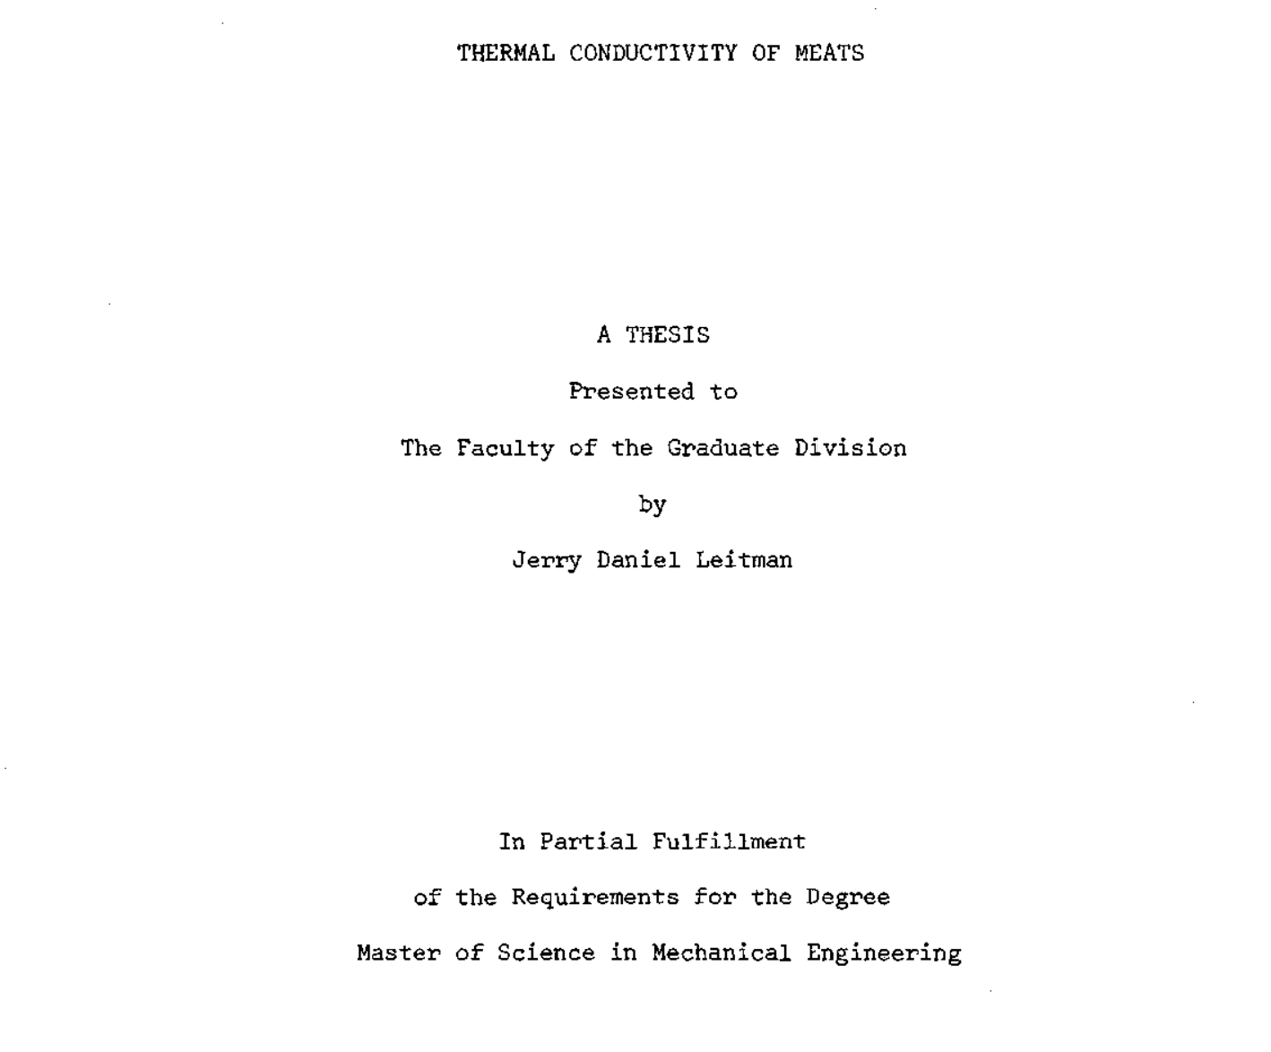
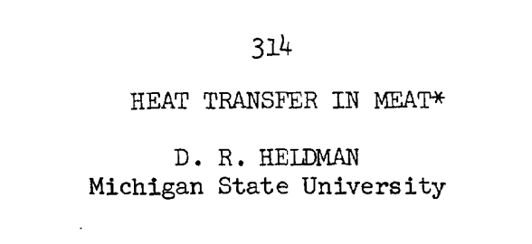
The papers
Referenced two papers:
One outlining equations to use
One to find thermal constants for meat

Slide 6
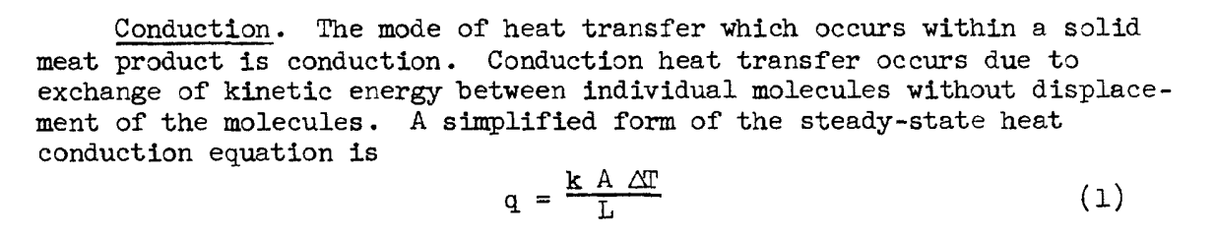
The math
NOT steady state solution
Use FTCS with boundary condition
Temperature set at 450 for grill grate, 400 for grill air, and 450 for cast iron
Insulate elsewhere

Slide 7
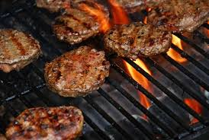
Why not a different method?
FTCS model deals with diffusion in medium
Initially tried steady state equation for conduction from paper
But, we didn’t want a steady state solution. We needed it to be time dependent, and so FTCS was the answer.

Slide 8
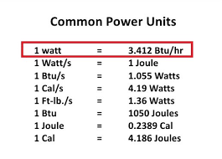
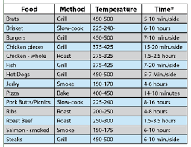
The numbers
For “Beef, lean, eye of loin, U.S. good grade”:
K = 0.185 BTU / (hr ft ℉) at 42℉
C = 0.56 BTU/(lb ℉)
𝛒 = 0.033 lb/ci
So 𝝟 = K / (c 𝛒) = 0.834 in²/hr
Convert to per in. and BTU / sec.

Slide 9
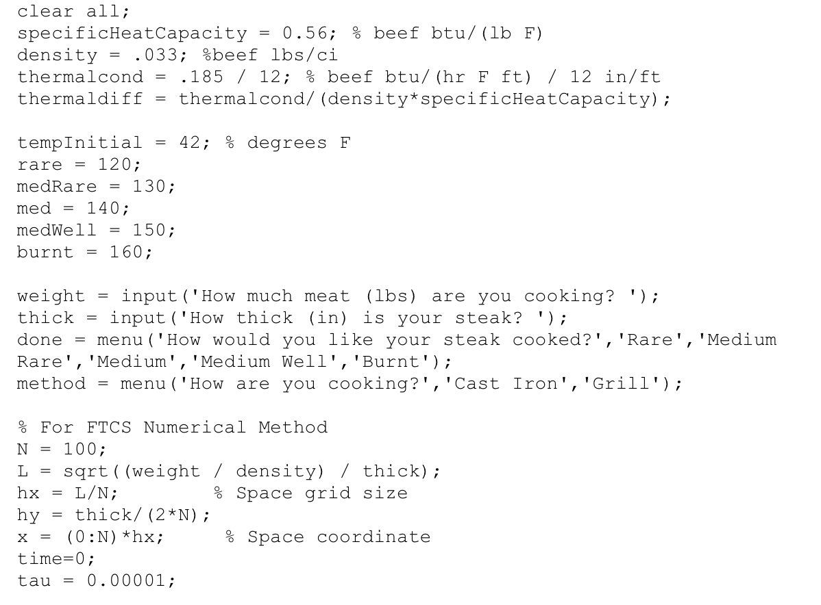
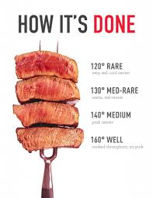
The program
Iteratively solve for temperature at half the thickness
Shows time to cook per side
Set constants
Demo!

Slide 10
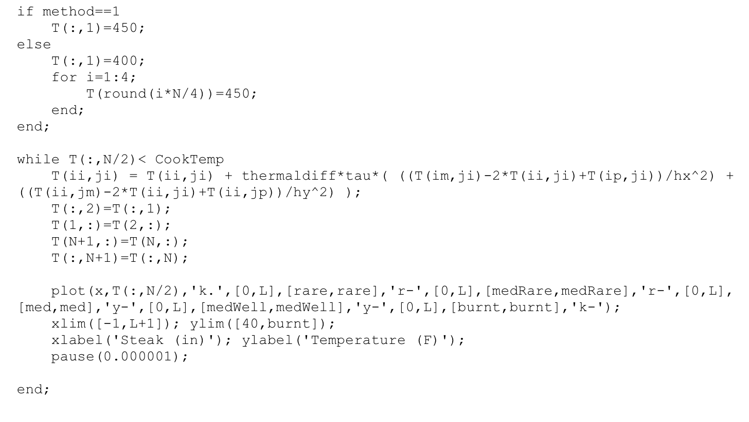
More program
2D FTCS method
Slow plotting, but we need tau small enough to not go crazy
Didn’t try to model heat loss to atmosphere

Slide 11
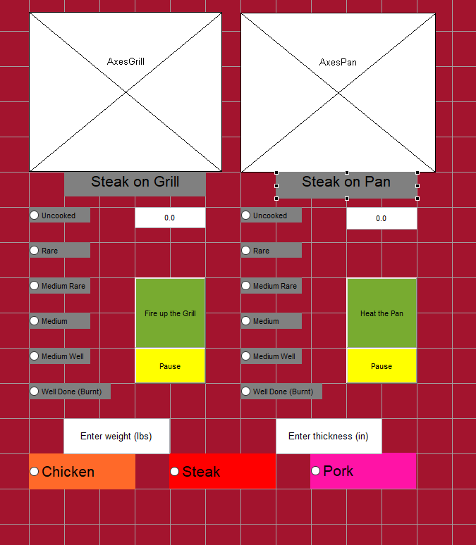
The GUI

Slide 12
Credits:
All images copyright www.google.com/images 2019.

